Slide 1
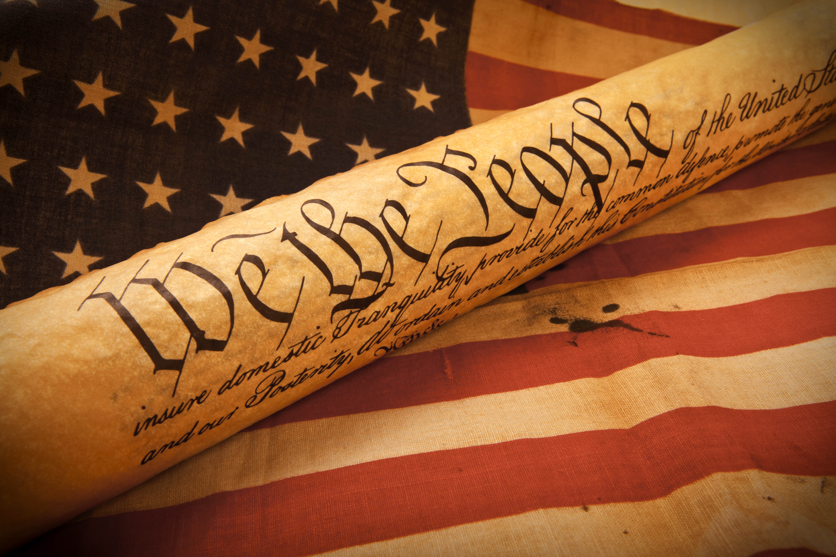
Constitution Day
September 17, 2015

Slide 2
What does this the Constitution mean to you?
What rights have you been guaranteed under the Constitution and the Bill of Rights? Take a few minutes to think-pair-share.
Notes:
Provide time to think-jot-pair-share.
Answers will vary.
Constitution:
Bill of Rights:
Freedom or Religion, Speech, & Press
Freedom to Petition & Assemble
Right to Bear Arms
Safeguards against unreasonable search and seizure
Right to due process
Right to not house soldiers
Right to a jury trial of your peers
Right to have property protected from the government (eminent domain)

Slide 3
Objectives
Today, we will study the First Amendment to the Constitution and the rights it guarantees American citizens.
We will:
Consider our prior knowledge and gain new knowledge about freedom of speech in society, businesses, and schools,
Explore how changes to society have impacted freedom of speech,
Critically read & analyze Supreme Court cases related to freedom of speech, &
Write a brief analytical response that makes a claim based on our studies.
.
Notes:
The First Amendment provides wide protection for the Freedom of Speech, but those freedoms do not automatically extend to students. Today, you will discover the rights you retain in regard to free speech when in school and think about the impact of case law on the First Amendment.

Slide 4
Think about . . .
What do you know about the term “freedom of speech” based on your personal experience, understanding from history classes, and knowledge you have gained from television, movies, and books?
Let’s take a few minutes to think-pair-share.
Notes:
Take a few minutes to think-pair-share

Slide 5
Think about this too . . .
How has the internet and/or technology impacted “freedom of speech” and what changes have you seen or experienced in your lifetime?
Let’s take a few minutes to think-pair-share.
Notes:
Take a few minutes to think-pair-share

Slide 6
First Amendment – Read the following and try to identify the five freedoms.
Congress shall make no law respecting an establishment of religion, or prohibiting the free exercise thereof; or abridging the freedom of speech, or of the press; or the right of the people peaceably to assemble, and to petition the Government for a redress of grievances.
– First Amendment to the U.S. Constitution
Notes:
Briefly deconstruct First Amendment… Give student two minutes to discuss and determine the 5 freedoms provided by the First Amendment. Give 2 minutes to work then next slide.

Slide 7
First Amendment
Congress shall make no law respecting an establishment of religion, or prohibiting the free exercise thereof; or abridging the freedom of speech, or of the press; or the right of the people peaceably to assemble, and to petition the Government for a redress of grievances.
Before we move on:
Please complete the three question pre-reading section of the Anticipation Guide for Constitution Day-Censorship in Schools handout.
Notes:
Briefly deconstruct First Amendment… Have a volunteer share the five freedoms they identified. 1 minute
Answer:
Freedom to choose and practice a religion.
Freedom of Speech
Freedom of the Press (News and Media).
Freedom to assemble (such as a protest).
Right to make a complaint or seek the assistance of the government, without fear of punishment
After this discussion, let student know today’s task will center around the Freedom of Speech. Have students complete the pre-reading section only of the Anticipation Guide for Constitution Day-Censorship in Schools handout.

Slide 8
The impact of case law on the First Amendment
Since the Constitution was established, its meaning has been challenged many times.
It is the role of the Supreme Court to interpret the meaning of the Constitution.
Key Supreme Court cases that clarify the Constitution are known as landmark cases.
The investigation of landmark cases helps determine rights.
Notes:
Teacher Note: Please read this slide as a segue into the next activity.

Slide 9
Two Key Cases Regarding Students’ Rights
Tinker v. Des Moines Independent Community School District (1969)
Bethel School District No. 403 v. Fraser (1986)
Click for Video Playlist
1-Working in pairs or small groups, read one of the cases, fill in the description & outcome on the chart, and be ready to share this with the class so we can jigsaw all of the answers.
2-Use the Supreme Court Processing Chart to Jigsaw Cases.
3-See the next slide for the complete answers.
Notes:
We suggest that you jigsaw the two cases so half of the class gets one case and the other half of the class gets the other case. Students will work in small groups to read one of the case descriptions and complete the Supreme Court Processing Chart to Jigsaw Cases (content frame). Have students complete the relevant portion of the handout with evidence from the selection.
Small Group Discussion: How did this case shape the rights that you have today in school? How might this case be used to support or deny student’s freedom of speech in school? Use evidence from the handout to support your position. Be prepared to share your thoughts, ideas, and evidence with the class.
Whole Class: A spokesperson will be selected from each group to share key findings about their case. Students will complete court case content frame and complete their anticipation guide with the correct information.
For Teacher to Share:
7 min

Slide 10
Case | Description | Outcome | Effect on First Amendment
Tinker v. Des Moines Independent Community School District (1969) | Students were suspended for wearing black armbands to school in 1965 to protest the Vietnam War. Their free speech was protected, even within the walls of the school building, because the behavior was quiet and passive and did not disrupt the school environment. | The US Supreme Court ruled that the suspensions of students, based on fear of disruption, violated students’ Free Speech clause of the First Amendment. Students could only be disciplined if there is a material and substantial interference with the requirements of appropriate discipline, the rights of others or the work of the school or any class. | Students do not “shed their First Amendment Rights at the school house door”. Court held that school officials cannot censor student speech unless school officials reasonably forecast that the speech will cause a material and substantial disruption of school activities or collide with the rights of others.
Bethel School District No. 403 v. Fraser (1986) | A student was suspended for speech that was deemed offensively lewd and obscene under the school’s rules. If the same speech was outside of the school environment, he could not have been penalized. | The US Supreme Court upheld the suspension of a high school senior and ruled that the First Amendment did not prevent the school district from disciplining him. | The court found that it was appropriate for the school to prohibit the use of vulgar and offensive language. Chief Justice Burger distinguished between political speech which the Court had protected in Tinker v. Des Moines.

Slide 11
After reading the cases . . .
Complete the three “Post-Reading” questions on the anticipation guide.
Use a sticky note or index card to respond to the following prompt and provide evidence from one of the case texts and/or your personal knowledge (history classes, textbooks, movies, etc.).
Prompt: Choose one the cases that we read today. Do you believe that the students’ first amendment rights were violated? Provide evidence to support your response.
Notes:
Students will review the anticipation guide with a new lens that includes the relevant court cases.
Students will be asked to write a position statement as to whether they believe, based in the reviewed case law, these students first amendment rights were violated. 5 minutes.

